Slide 1
Lecture 1
Algorithms – Binary search, Selection sort, Newton Raphson and other successive approximation techniques

Slide 2

Binary Search
31
number to search
0 1 2 3 4
23 31 58 100 212
Array to search
0 1 2
23 31 58
1
31
Found

Slide 3
Selection Sort
23 | 5 | 203 | 12 | 1
0 | 1 | 2 | 3 | 4 | Swaps
1 | 5 | 203 | 12 | 23 | 1 and 23
1 | 5 | 203 | 12 | 23 | Doesn’t swaps
1 | 5 | 12 | 203 | 23 | 12 and 203
1 | 5 | 12 | 23 | 203 | 23 and 203
List is now sorted

Slide 4
Successive approximation techniques for finding roots of an equation
Newton Raphson Method
Chebyshev method
Secant method
False position
Fixed point iteration etc

Slide 5
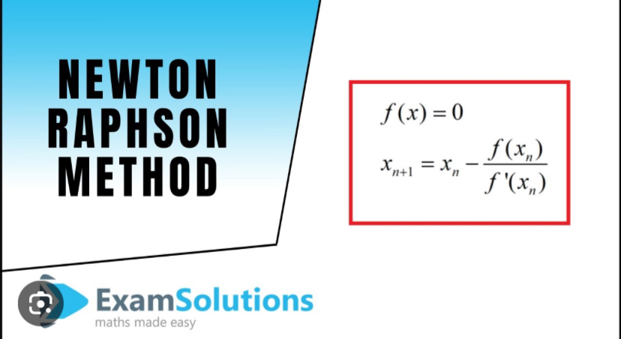
Newton Raphson method

Slide 6
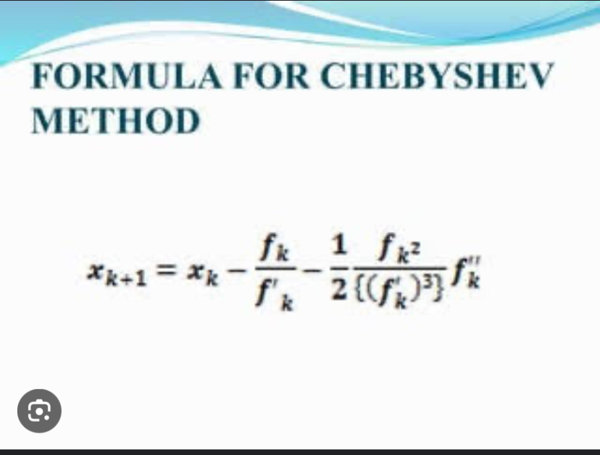
Chebyshev method

Slide 7
Problem 1
Find the positive root of the equation f(x) = x^{3 –} 5x + 1, take initial approximation X₀ = 0.5
Use newton Raphson and Chebyshev method

Slide 8
Problem 2
Find the square root of 16. The equation is given as f(x) = x² – n.
N/B = n is the number you are looking for the square root.
Use newton Raphson and Chebyshev method

